Slide 1

Interoperability with On-Chain Bridges and Wallets
@stse harmony.one/talk

Slide 2
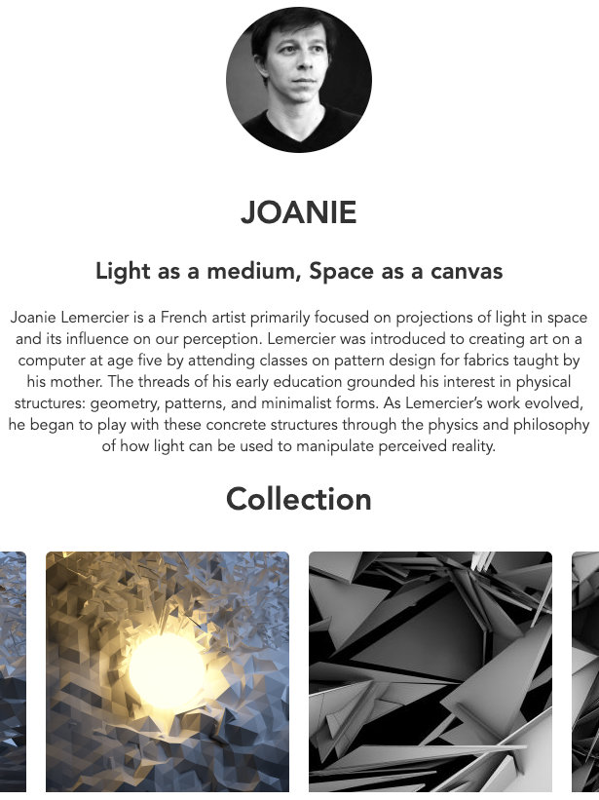
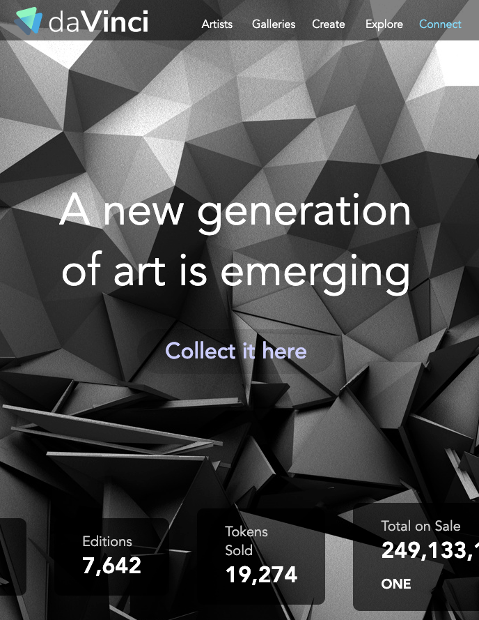
Harmony: Scaling Cross-Chain Applications
109 open validators staking $540m, 11k on-chain delegations, 77.8k wallets
41 EVM apps w/ $52M cross-chain assets #Green NFT: 865 artists, $269k sales, davinci.gallery with curation & auctions

Slide 3
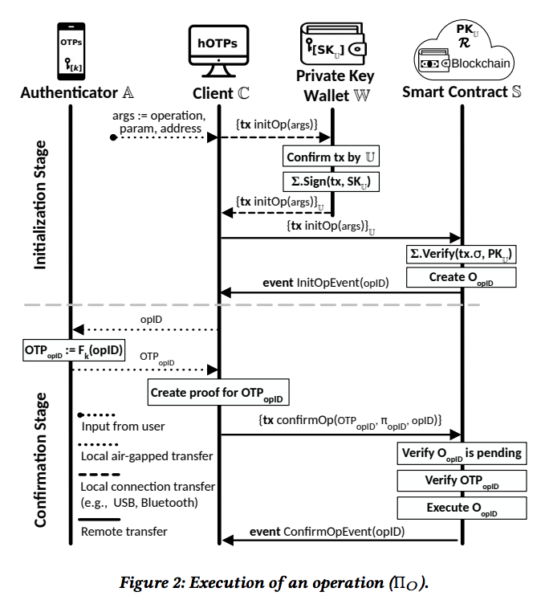
Roadmap: On-Chain Wallets for 1M users
Social recovery: no seed phrases, no SMS, only Google Authenticator (based on SmartOTP)
On-chain security via smart contracts
User focused: Argent, Loopring, Gnosis Safe
20% fixed-rate yields on cross-chain assets, staking derivatives as universal basic income

Slide 4
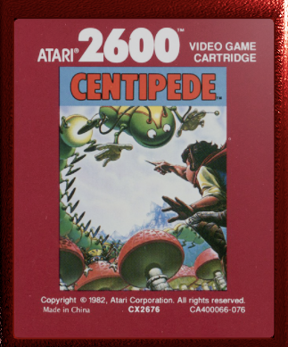
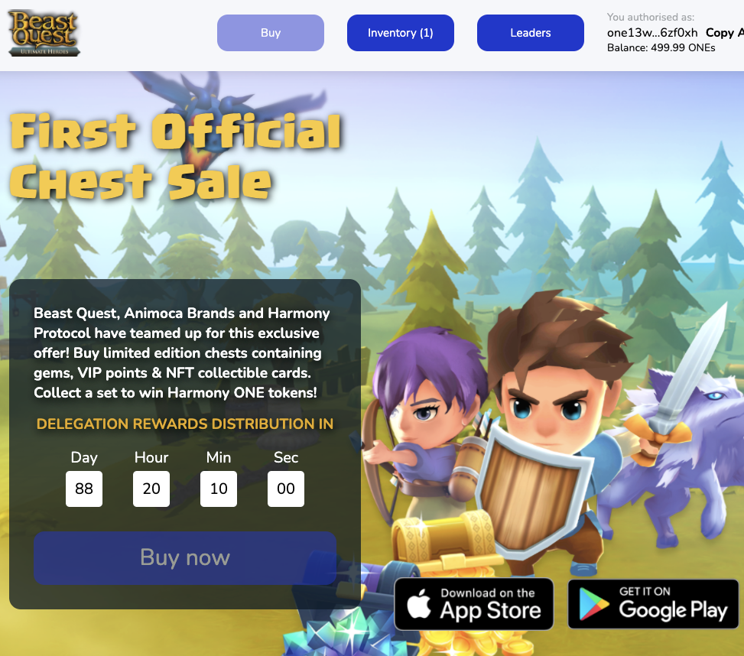
Digital Identity & Cross-Chain NFT
Multi-chain marketplace for airdrops, editorials, galleries; soon community NFT around events
Quidd & Atari branded assets with Animoca
Crazy.ONE name service, emoji domains 👩‍👩‍👧‍👦 as digital profile, pseudonym vs private wallets

Slide 5
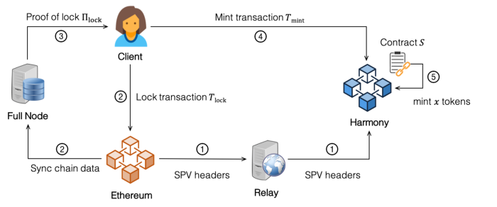
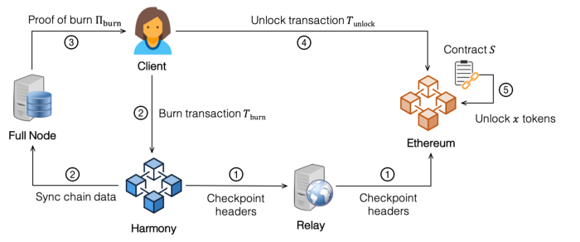
On-Chain Bridges to PoW & PoS Networks
ETH: Trustless bridge with 3-min finality based on our Flyclient research whitepaper
BSC: composing liquidity with high yields
BTC: capital-efficient, non-custodial vaults
DOT: extensions to WASM and parachains

Slide 6
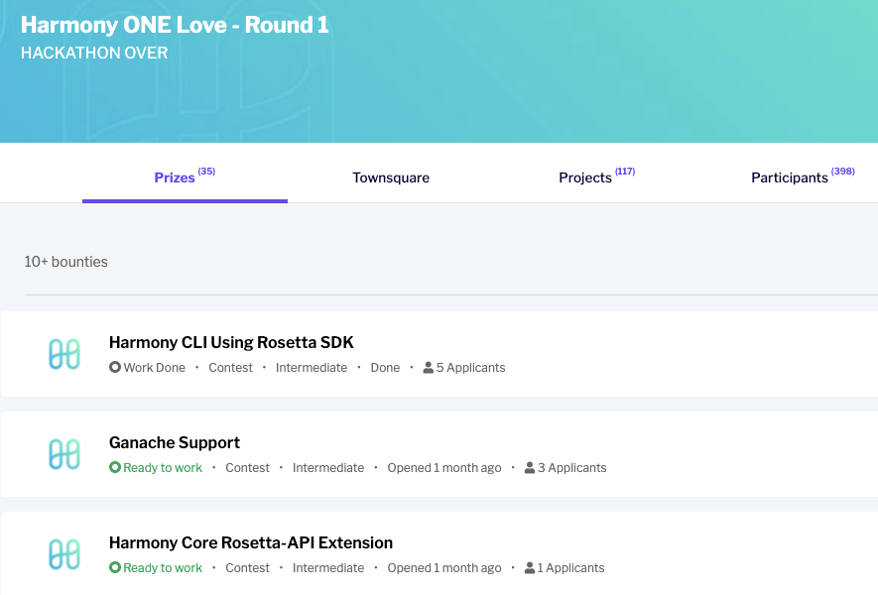
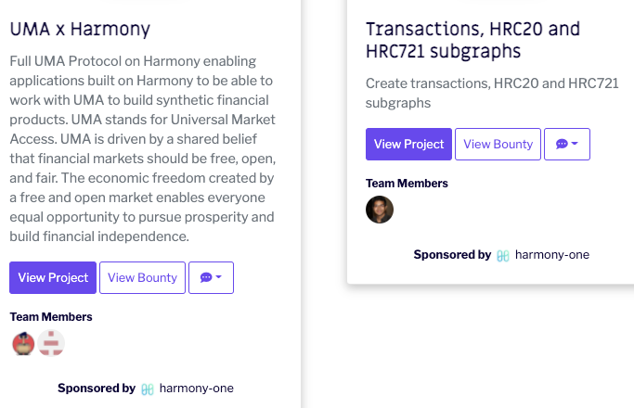
$10M Gitcoin Bounties
10 bridges, zk-zk rollups, data committee, api for cross-chain aggregator & yield
Protocol: VDF resharding, RaptorQ gossips
“Ethereum 3”: cryptographic primitives, ZKProof-based privacy, formal verification
Language-based security w/ types & Coq

Slide 7
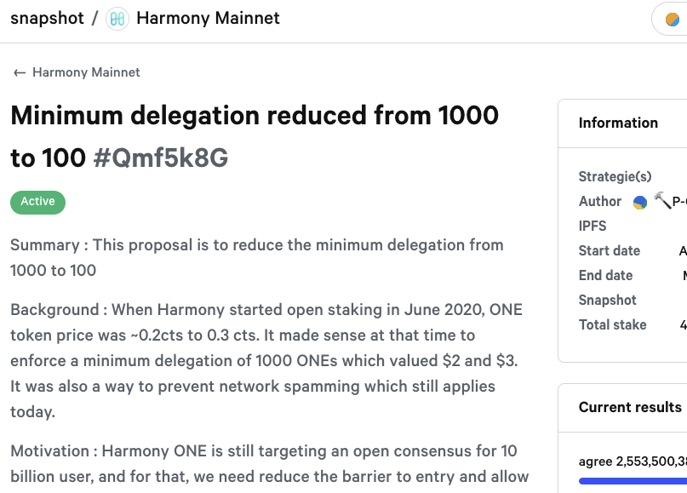

10 Community DAO
Validator governance: Snapshot, Gnosis Safe
10 DAO each w/ $1M: project incubation, product referrals, events, social fairness
radical marketplace for revealing true preference & support multi-round auctions
WANTED: advocates, education campaigns

Slide 8

On-Chain Bridges & Wallets
harmony.one/strategy
Developers & Community 💙 DAO
harmony.one/ecosystem
Cross-Chain Finance & Digital Arts
harmony.one/roadmap
$10M Bounties, We are HIRING!
harmony.one/bounties
@stse s@harmony.one

Slide 9
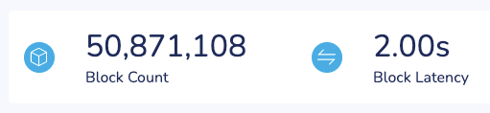
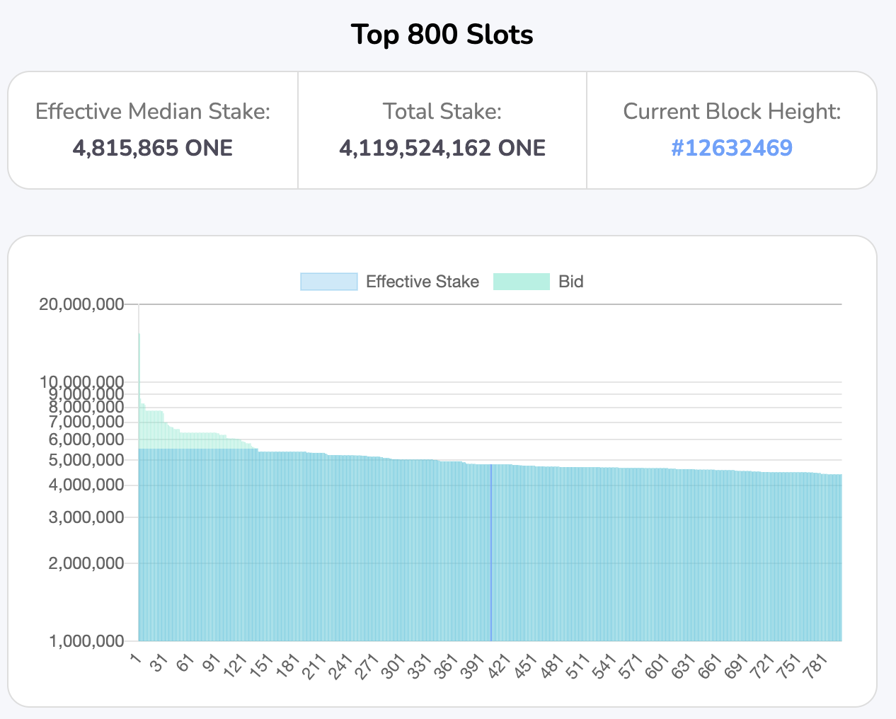
Protocol Features: Sharding & Staking
2-second finality with 1-block confirmation
Mainnet since 2019: 4 shards, $0.001 fees
BLS aggregated signatures, first chain with view change in production, 250 shard size
Fair staking: on-chain delegation & slashing

Slide 10
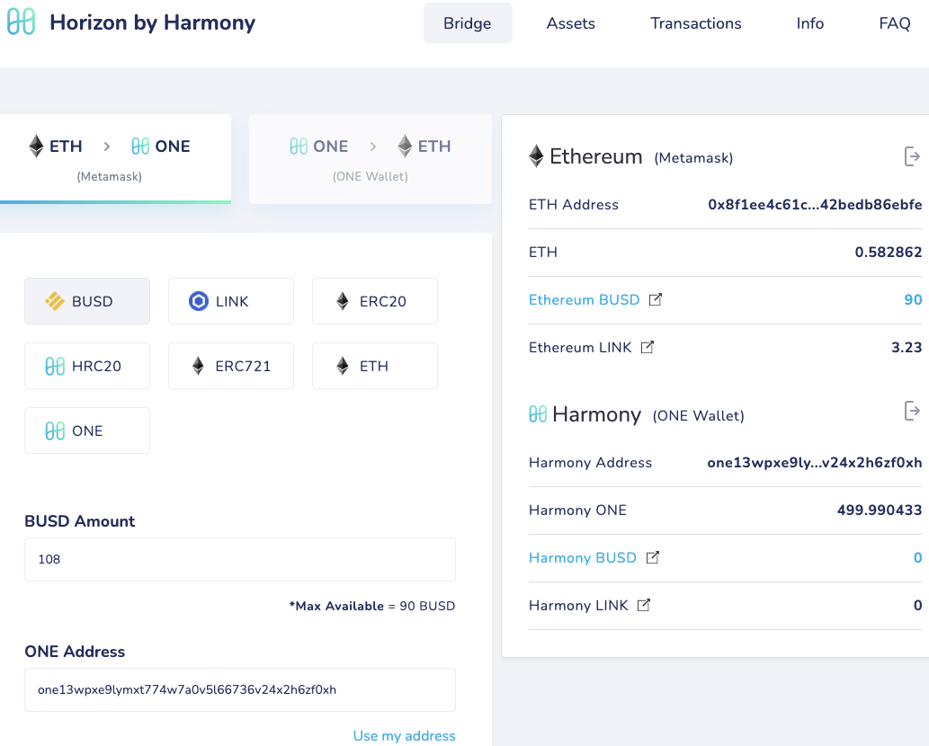
Interoperability with Ethereum as Layer 2
Fully bytecode compatible w/ Ethereum VM
Layer 2 w/ on-chain sharding, staking, bridges
Web3.js, Truffle, Metamask, 6 fiat gateways
3-minute withdrawals (based on validity proofs) vs 7-day for optimistic rollups

